Slide 1
Hidden Markov Model
Xiaoxuan Han, Sep 29th 2022

Slide 2
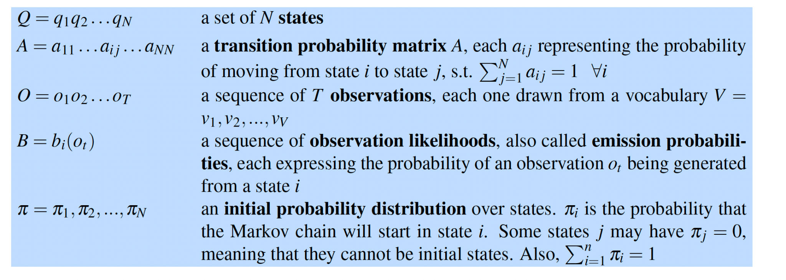
What is a Hidden Markov Model?
A hidden Markov model (HMM) allows us to talk about both observed event Markov model (like words that we see in the input) and hidden events (like part-of-speech tags) that we think of as causal factors in our probabilistic model.

Slide 3


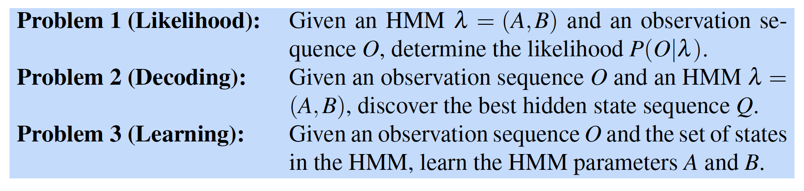
Assumptions
A first-order hidden Markov model instantiates two simplifying assumptions
The probability of a particular state depends only on the previous state
The probability of an output observation depends only on the state that produced the observation and not on any other states or any other observations
Three fundamental problems：

Slide 4
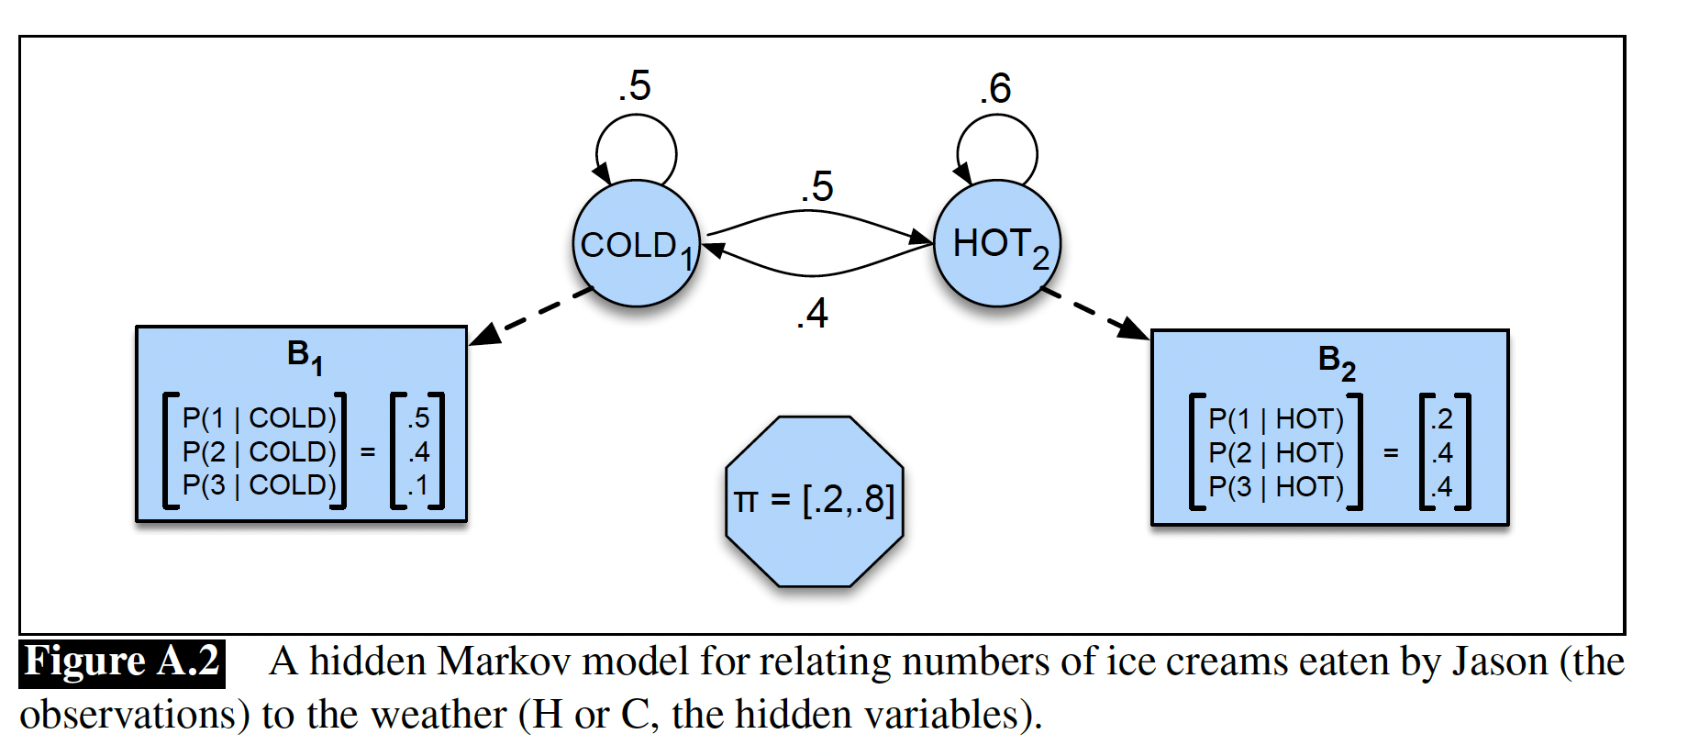
Example
The two hidden states (H and C) correspond to hot and cold weather, and the observations (drawn from the alphabet O = f1;2;3g) correspond to the number of ice creams eaten by Jason on a given day.

Slide 5
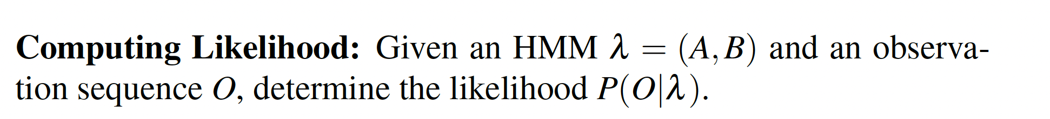
Likelihood Computation: The Forward Algorithm
For an HMM with N states and an observation of T observations, there are N^{T} possible hidden sequences → too large to compute
Thus, we use the forward algorithm O(N²T) - The forward algorithm computes the observation probability by summing over the probabilities of all possible hidden state paths that could generate the observation sequence, but it does so efficiently by implicitly folding each of these paths into a single forward trellis.

Slide 6
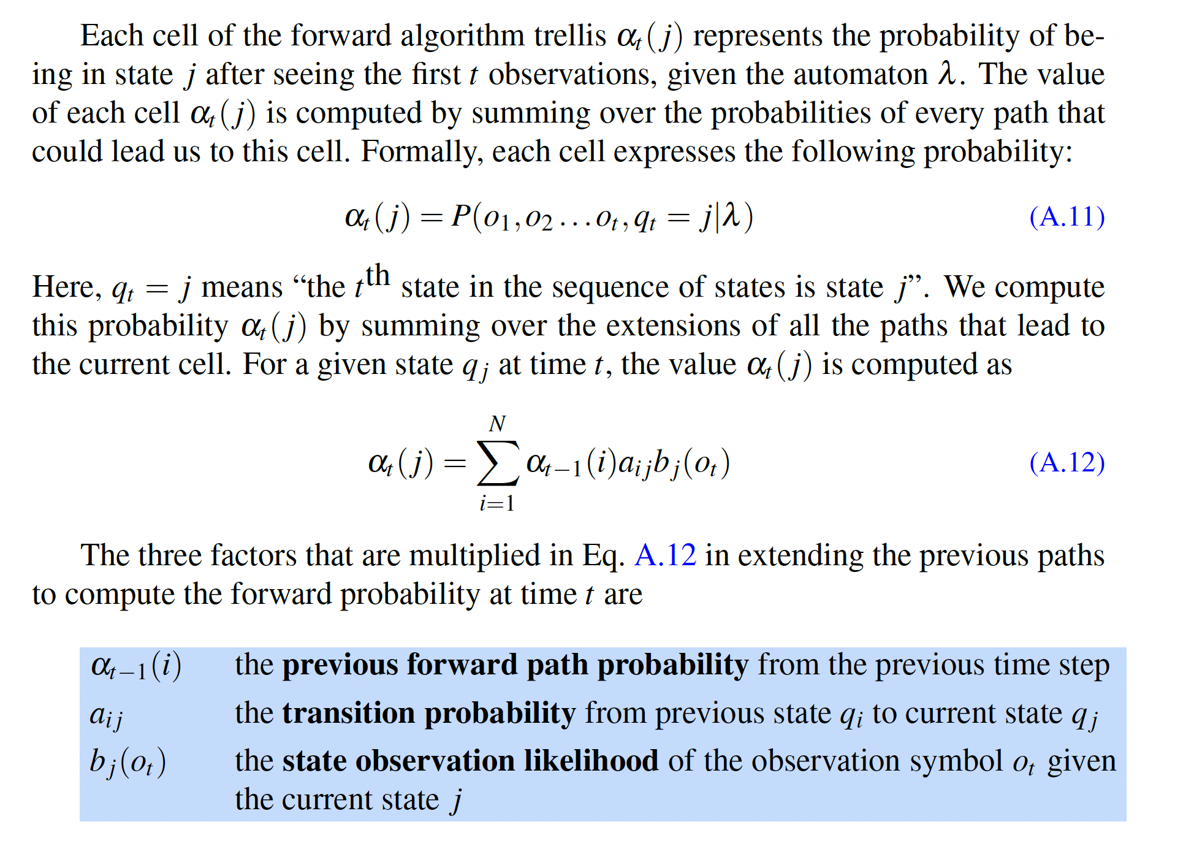

Slide 7
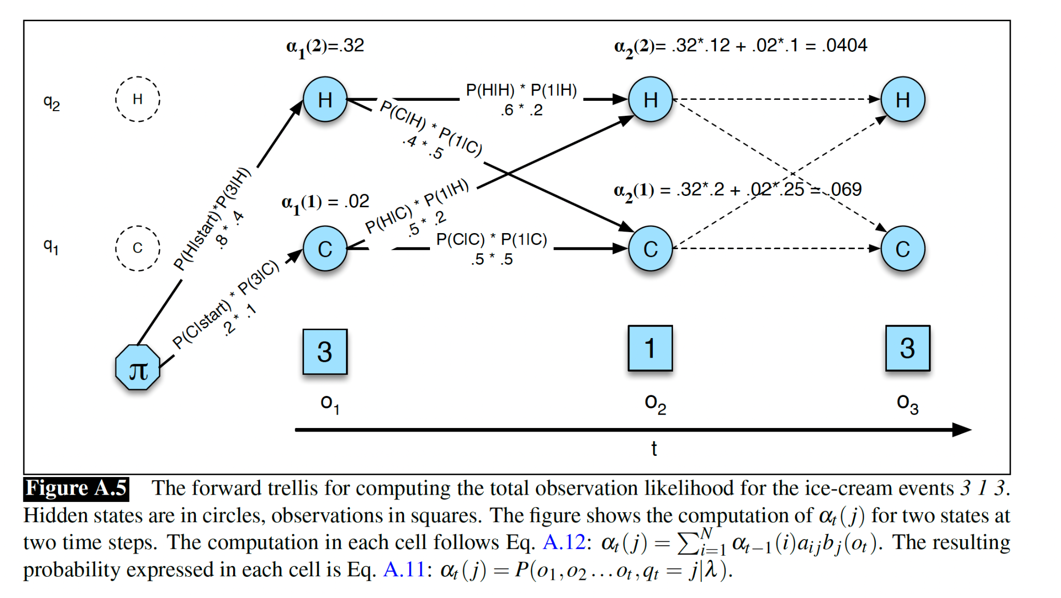

Slide 8
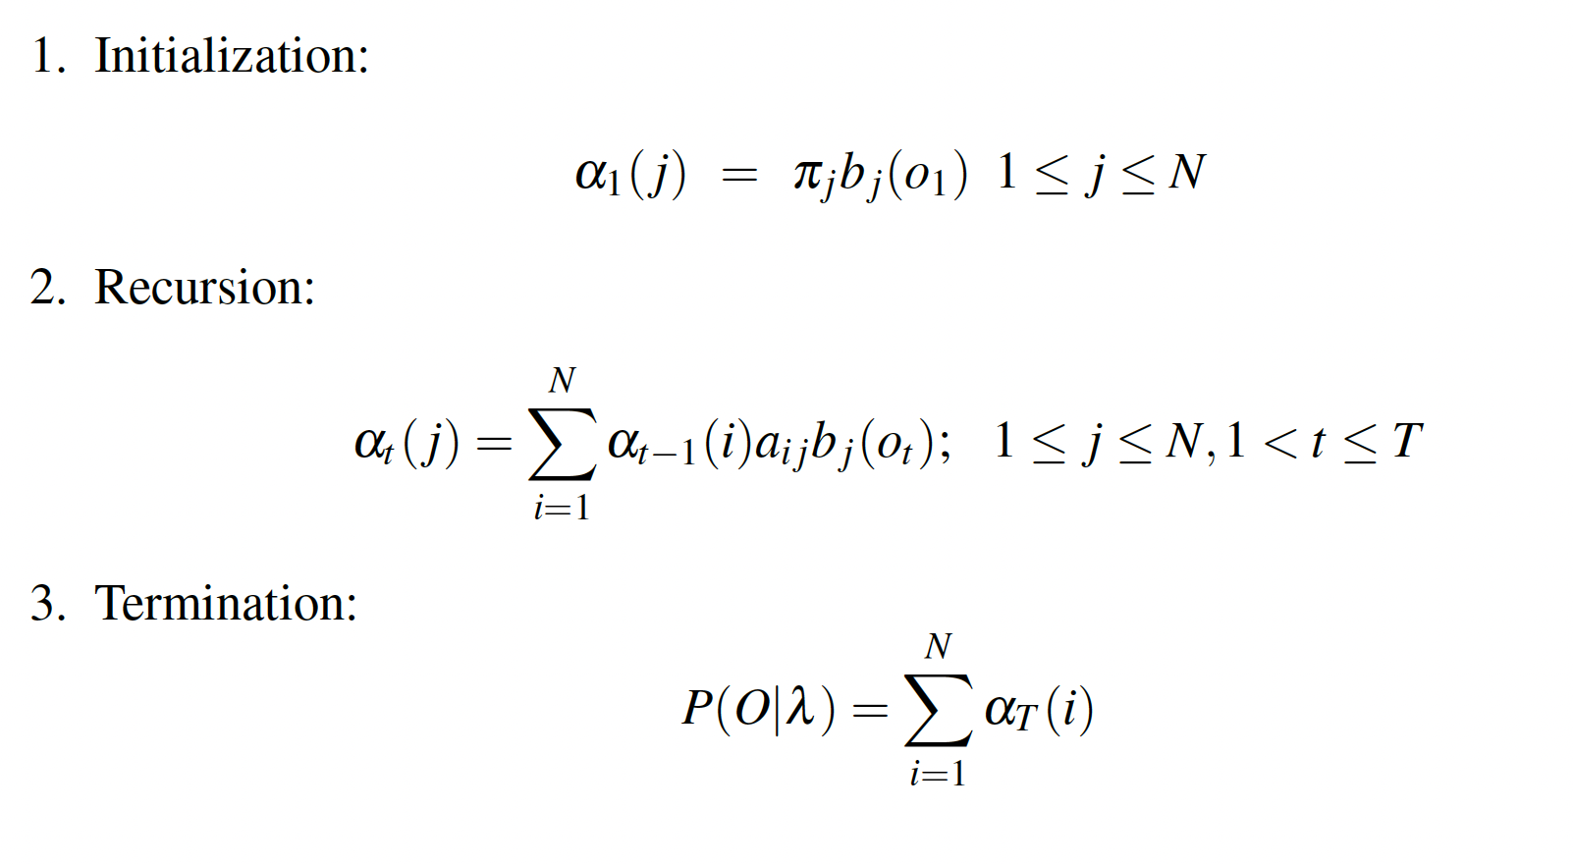
Algorithm Steps

Slide 9
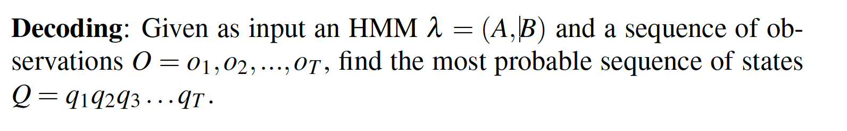
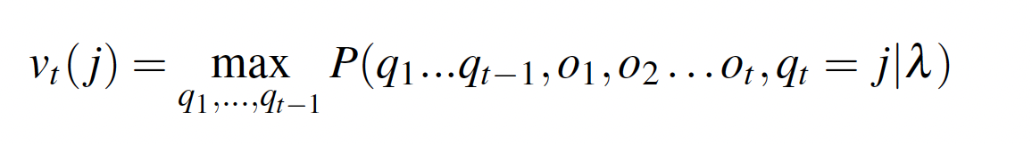
Decoding: The Viterbi Algorithm
Decoding: the task of determining which sequence of variables is the underlying source of some sequence of decoding observations
In HMM:
The probability that the HMM is in state j after seeing the first t observations and passing through the most probable state sequence q₁, …, q_{t-1}, given the automaton λ → calculated recursively

Slide 10
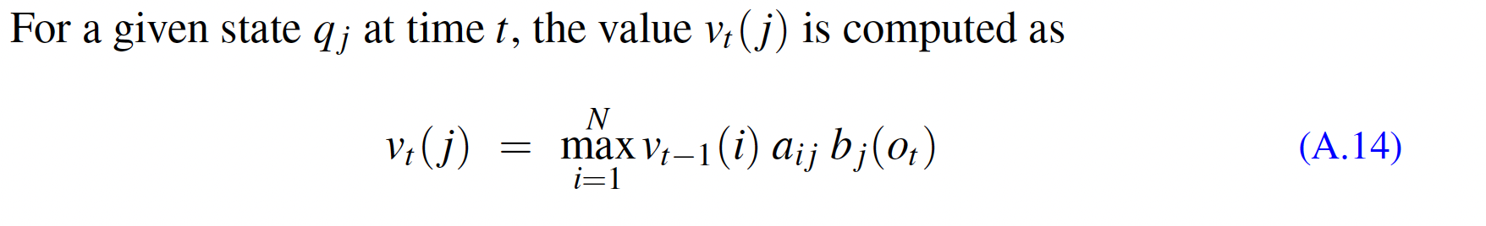
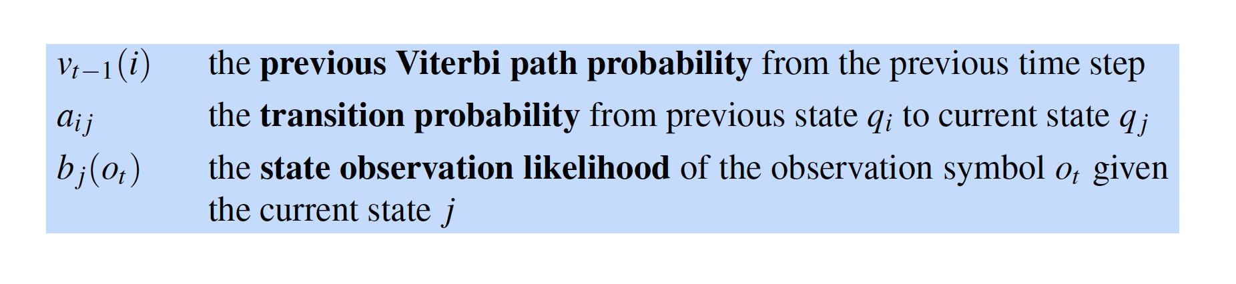
Decoding: The Viterbi Algorithm

Slide 11
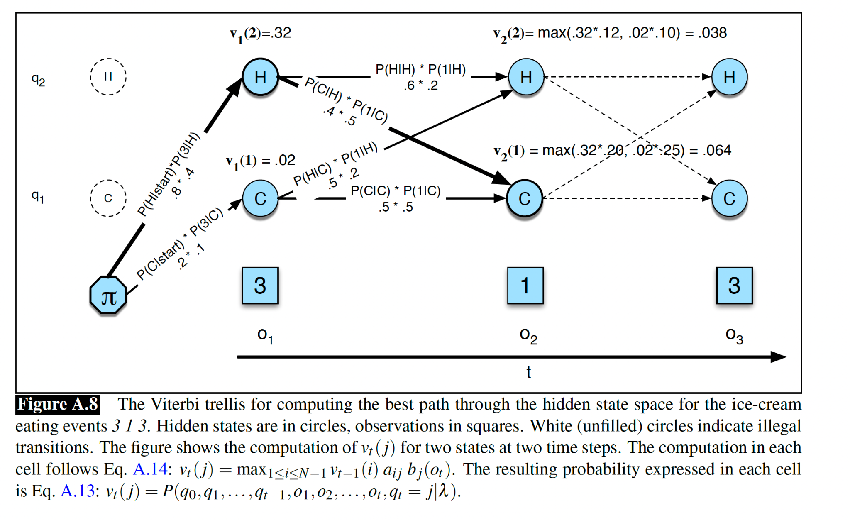

Slide 12
Decoding: The Viterbi Algorithm
Summary:
Viterbi algorithm is identical to the forward algorithm except that it takes the max over the previous path probabilities whereas the forward algorithm takes the sum.
Viterbi algorithm has one component that the forward algorithm doesn’t have: backpointers. The reason is that while the forward algorithm needs to produce an observation likelihood, the Viterbi algorithm must produce a probability and also the most likely state sequence. We compute this best state sequence by keeping track of the path of hidden states that led to each state, and then at the end backtracing the best path to the beginning (the Viterbi backtrace).

Slide 13
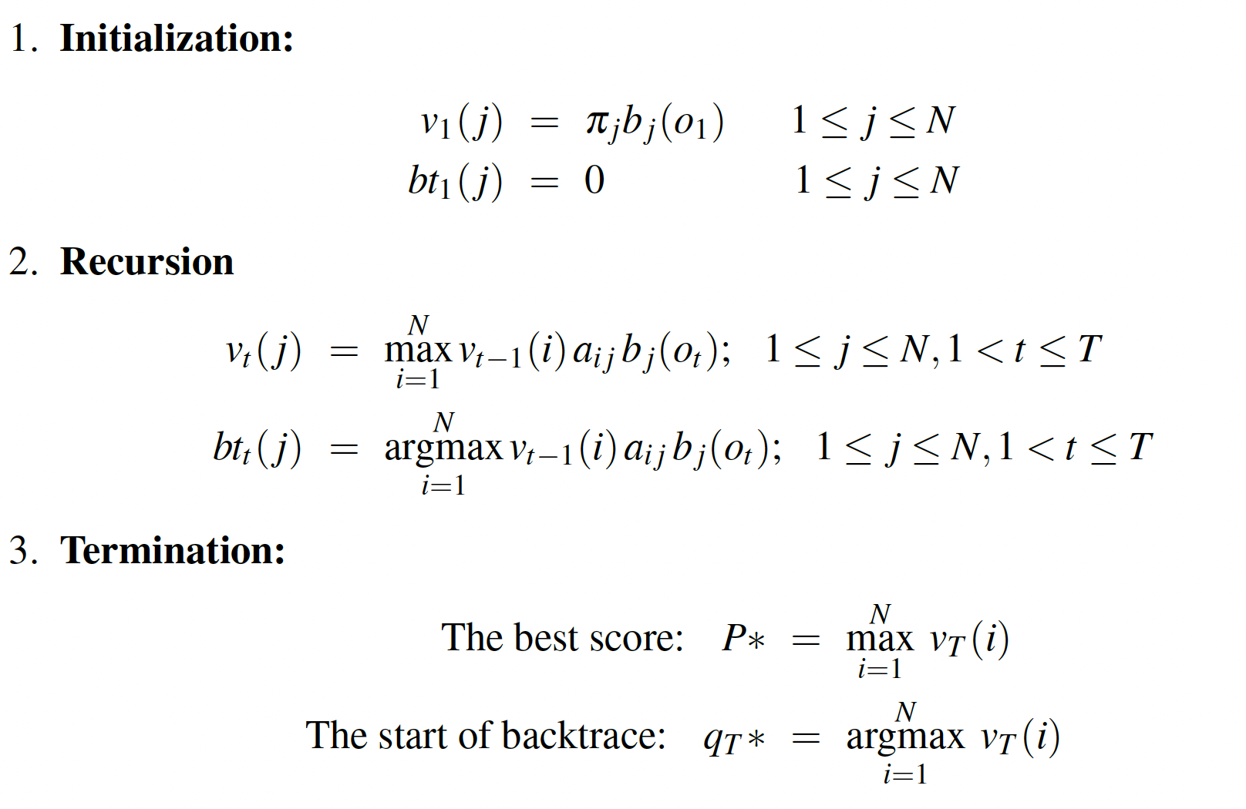
Viterbi Recursion

Slide 14
The Forward-Backward (Baum-Welch) Algorithm
Learning:
Given an observations sequence O and the set of possible states in the HMM, learn the HMM parameters A (transition probabilities) and B (emission probabilities).
Problem to be solved:
We cannot compute counts directly from an observation sequence since we don’t know which path of states was taken through the machine for a given input.
Backward probability:
The probability of seeing the observations from time t+1 to the end, given that we are in state i and time t (and given the automation λ)

Slide 15
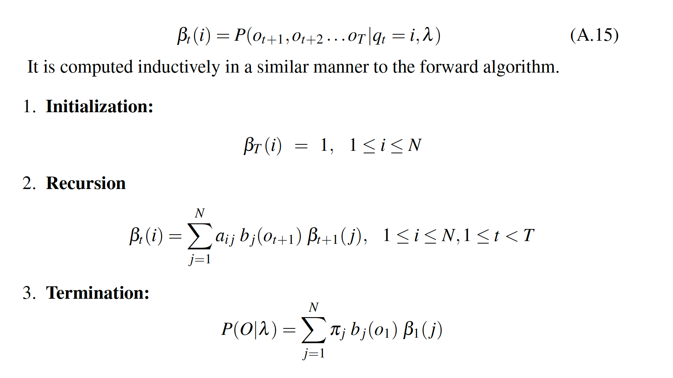
Backward Probability

Slide 16
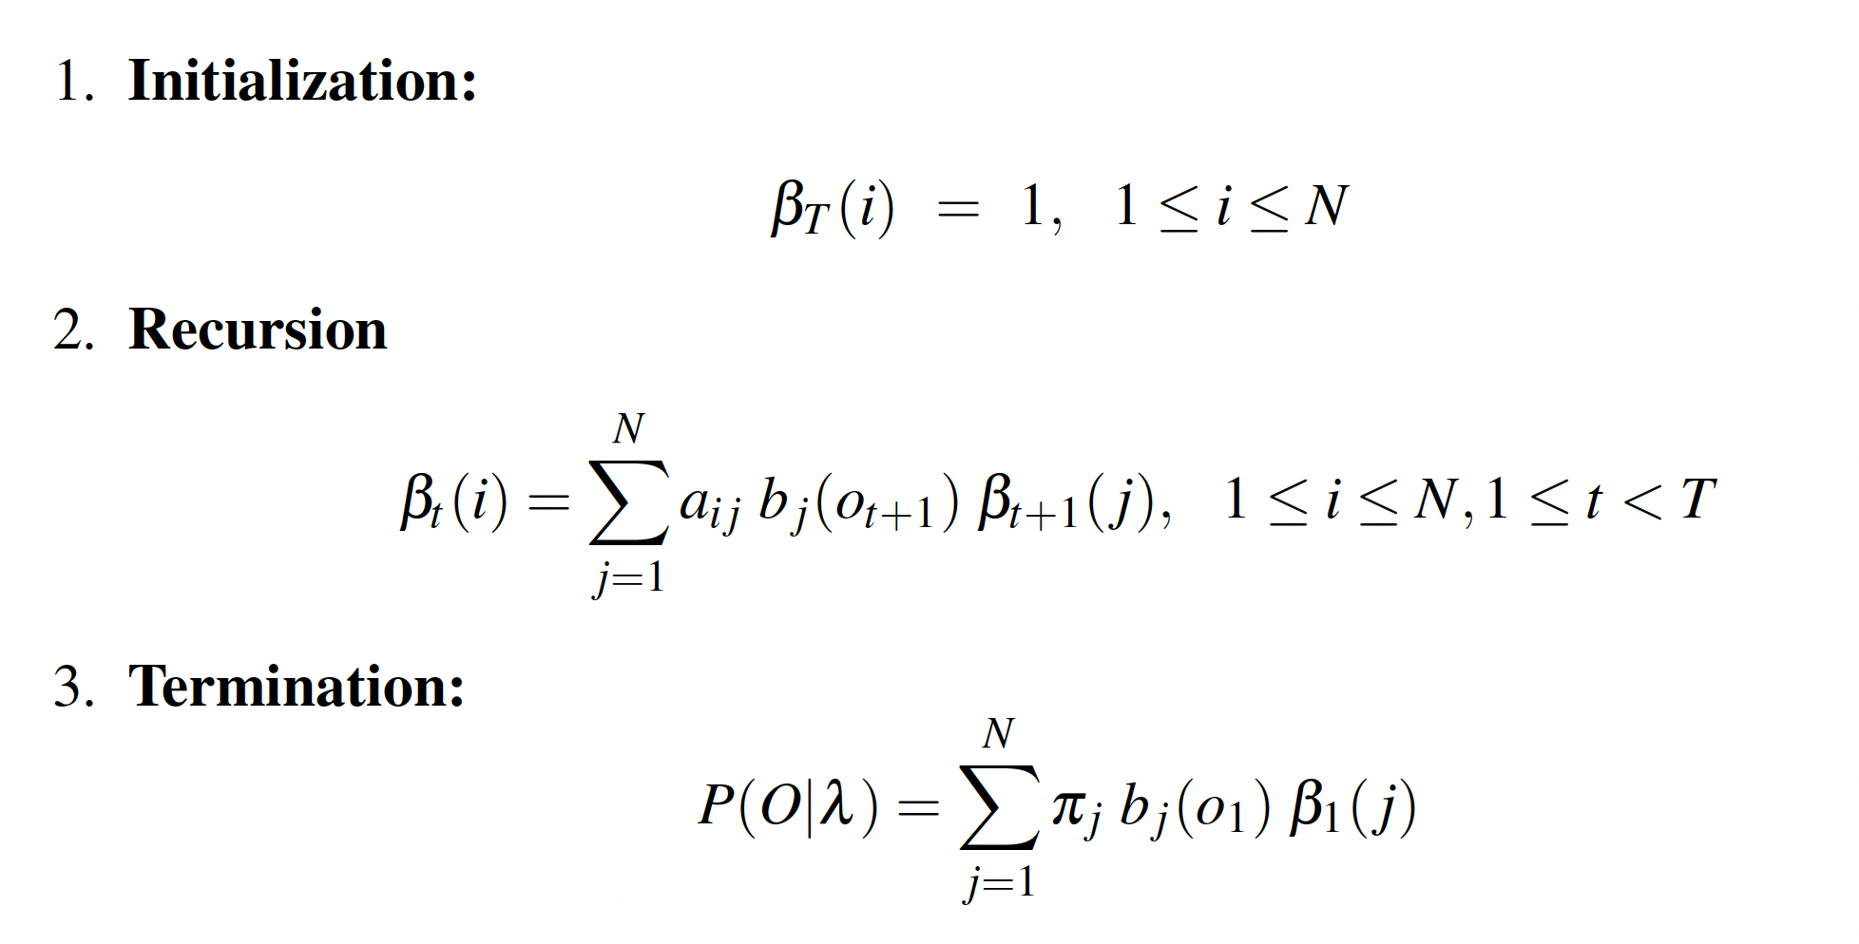
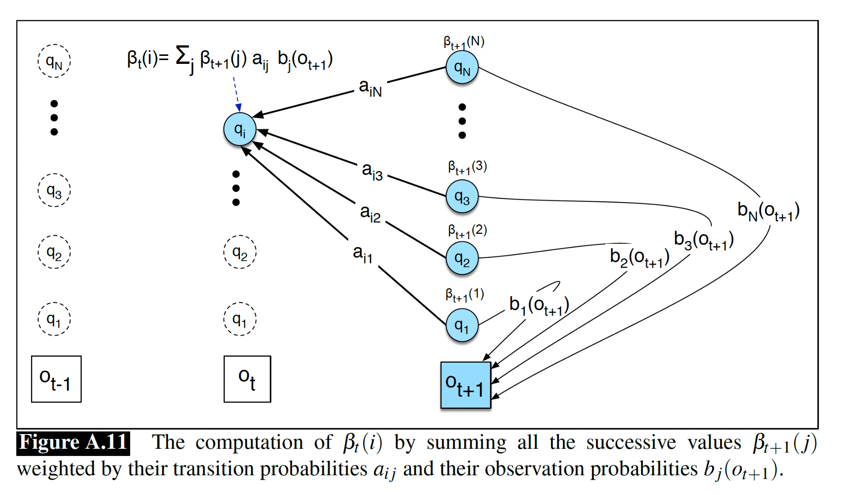
Backward Recursion

Slide 17
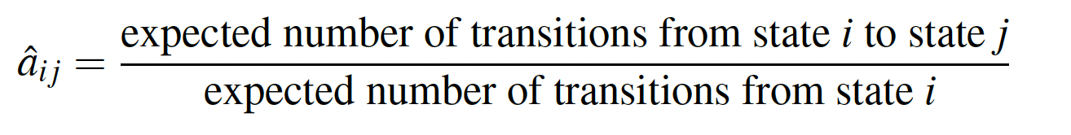
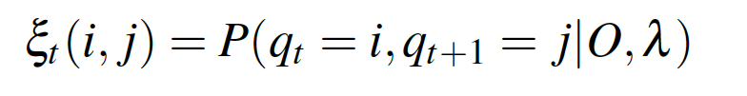
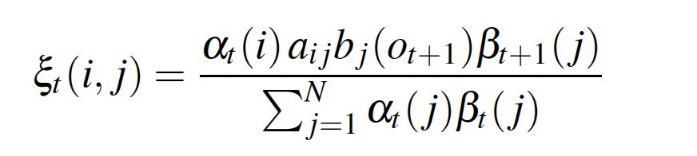
Optimizing Transition Probabilities
Assume we had some estimate of the probability that a given transition i → j was taken at a particular point in time t in the observation sequence. If we knew this probability for each particular time t, we could sum over all times t to estimate the total count for the transition i → j.
The probability of being in state i at time t and state j at time t +1, given the observation sequence and of course the model:

Slide 18
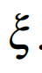
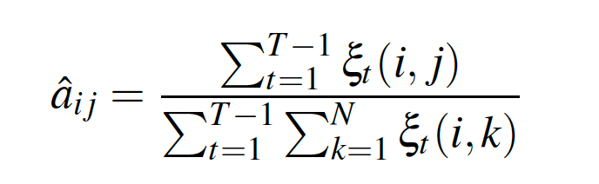
Optimizing Transition Probabilities Cont’d
The expected number of transitions from state i to state j is then the sum over all t of .
For our estimate of a_{ij} we just need one more thing: the total expected number of transitions from state i. We can get this by summing over all transitions out of state i.

Slide 19
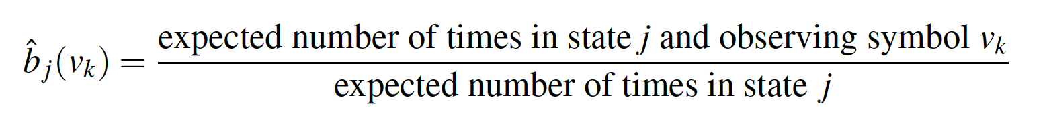
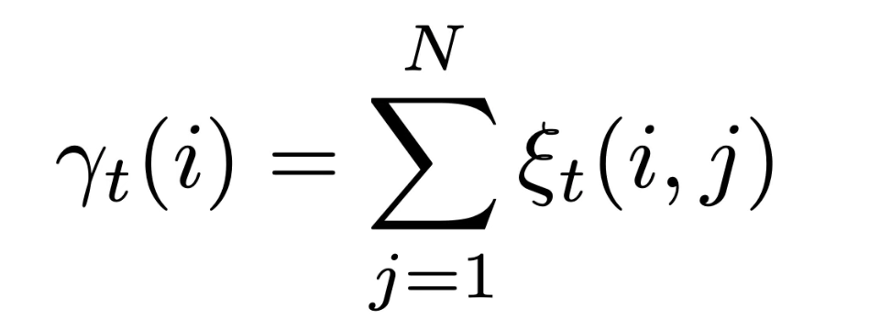
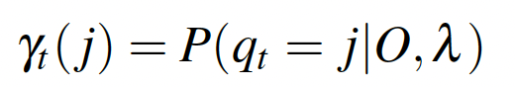
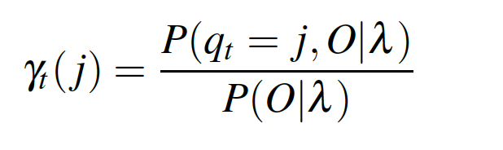
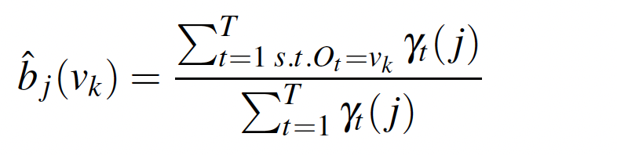
Optimizing Observation Probabilities
This is the probability of a given symbol v_{k} from the observation vocabulary V, given a state j:
We will need to know the probability of being in state j at time t.
Compute this by including the observation sequence in the probability

Slide 20
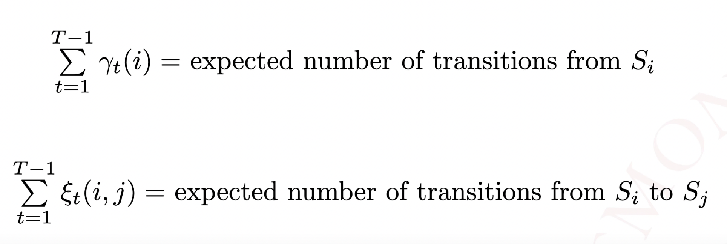
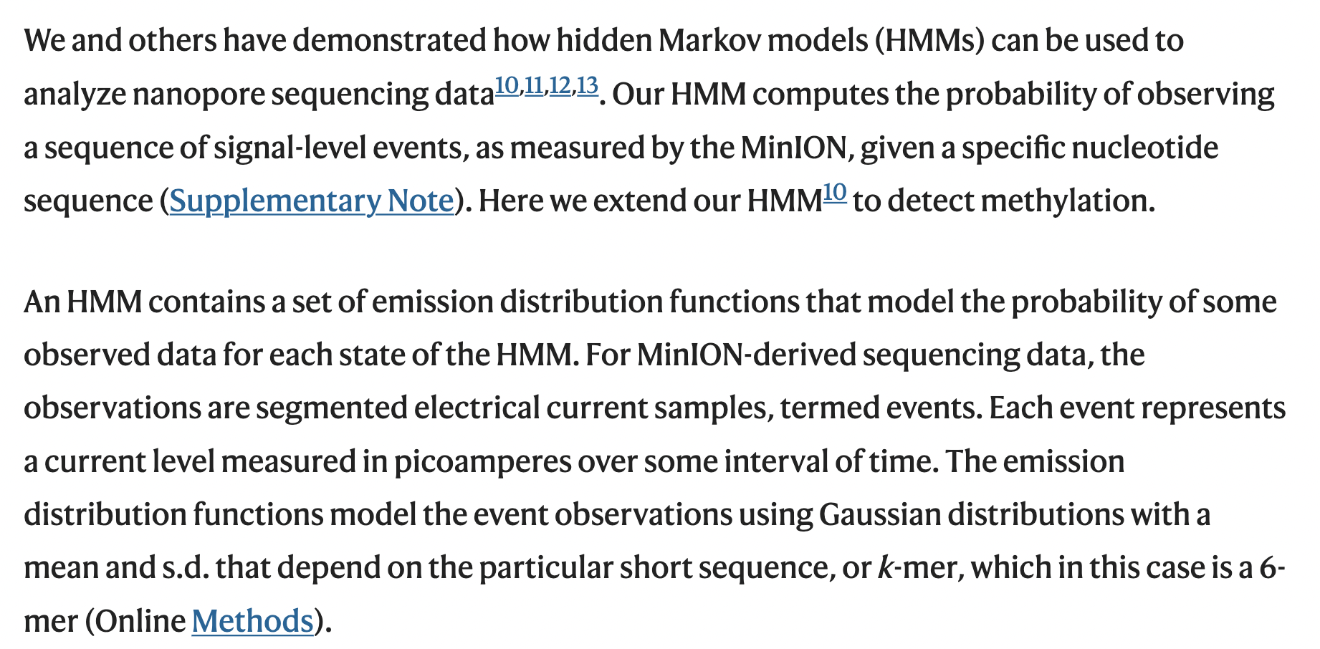
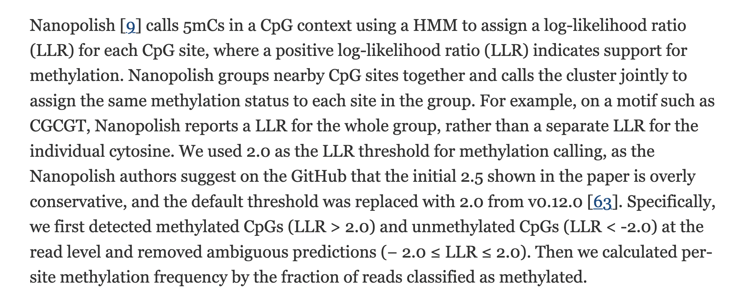
Supplementary Notes

Slide 21
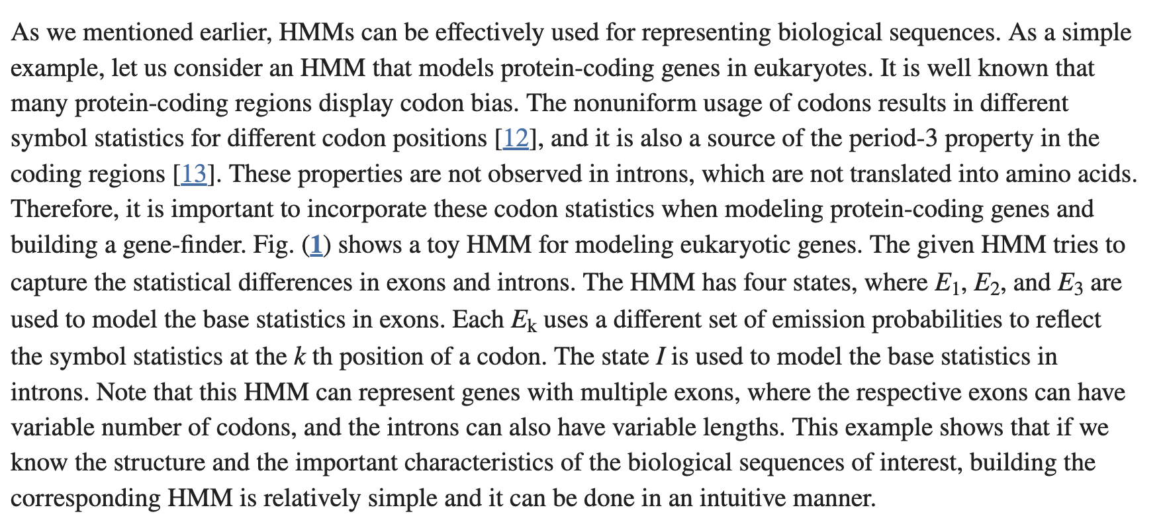
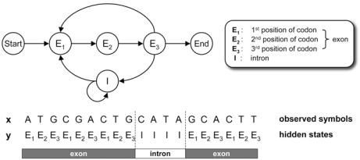
Supplementary Notes
Notes:
Hidden Markov Model and their applications in biological sequence analysis: https://www.ncbi.nlm.nih.gov/pmc/articles/PMC2766791/

Slide 22
References
Yoon BJ. Hidden Markov Models and their Applications in Biological Sequence Analysis. Curr Genomics. 2009 Sep;10(6):402-15. doi: 10.2174/138920209789177575. PMID: 20190955; PMCID: PMC2766791.
Chapter Hidden Markov Models. Speech and Language Processing. Daniel Jurafsky & James H. Martin.

